Slide 1
Photos and Questions re: the Trachea

Slide 2
Trachea pictures (low, medium, higher power)

Slide 3
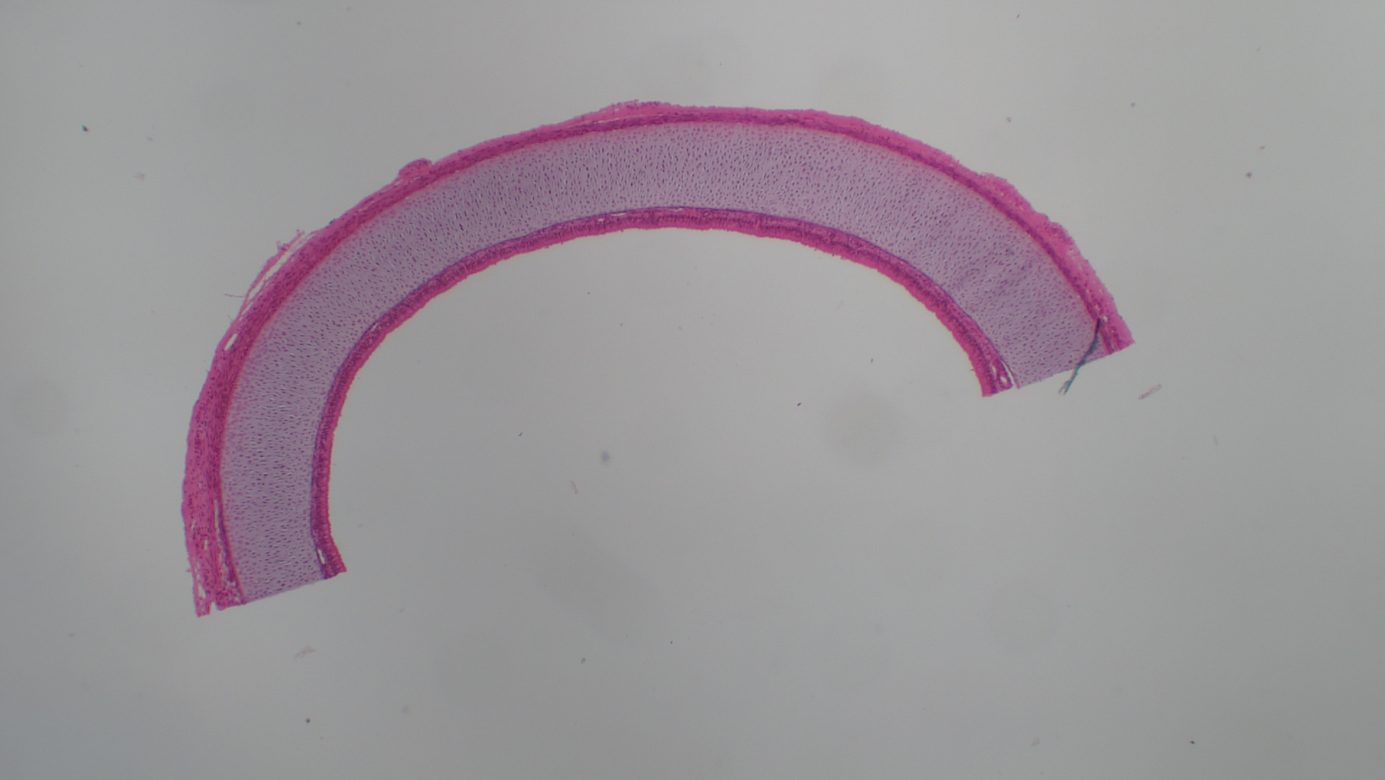

Slide 4
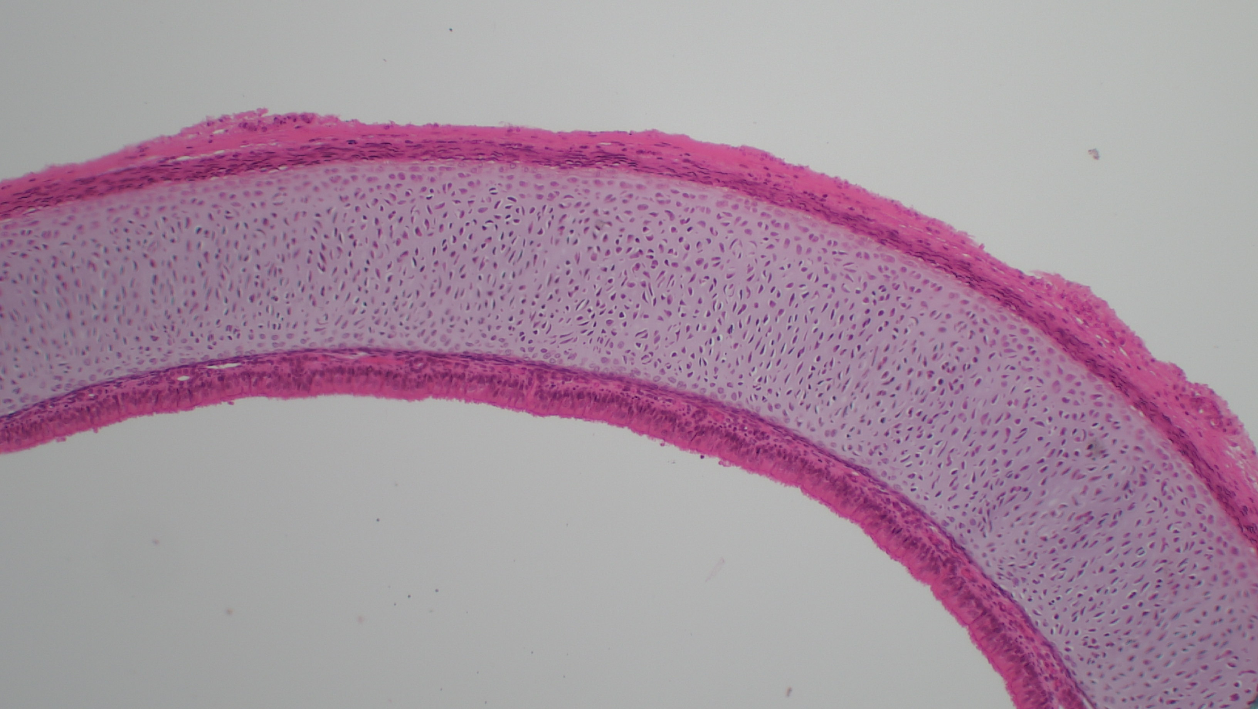

Slide 5
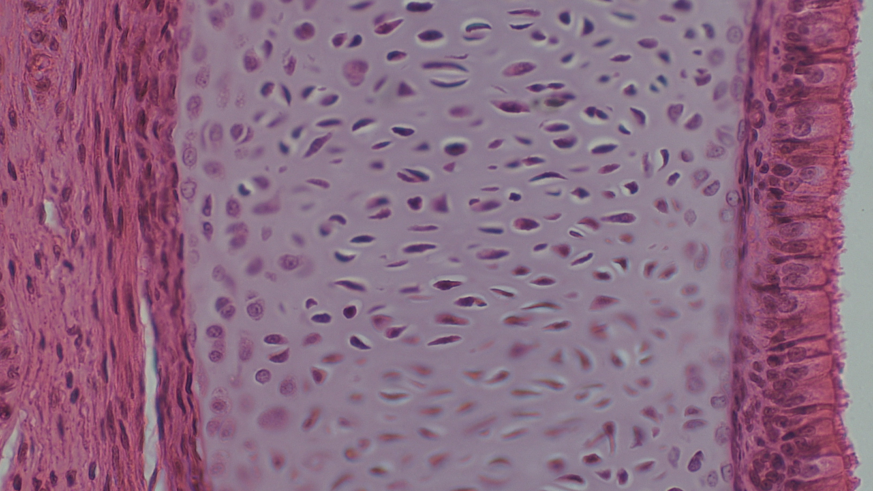

Slide 6
Questions for the Trachea (3 photos)

Slide 7
Why is there a straight line here? (answer: B)
It’s the edge of the organ.
The tissue was cut here during preparation.
This is where you find skin.
This is the lumen.

Slide 8
A
B
C
D
Where do you find the lumen? (answer: D)

Slide 9
In the body, what shape is this organ? (answer: A)
tubular, like a cylinder
spherical, like a ball
rectangular
cuboid

Slide 10
What type of tissue do you find next to the lumen? (answer: A)
epithelial
connective
muscle
neural

Slide 11
What type of epithelium does this tissue have? (answer: D)
simple squamous epithelium
simple columnar epithelium
stratified squamous epithelium
pseudostratified ciliated columnar epithelium

Slide 12
Epithelium always sits on a _______. (answer: C)
blood vessel
dermal papilla
basement membrane
mesothelial lining

Slide 13

*
*
What tissue do we see under the basement membrane? (answer: B)
bone
cartilage
blood
ligaments

Slide 14
*
*
Cartilage is a subtype of ______ tissue. (answer: B)
epithelial
connective
muscle
neural

Slide 15
What organ is this? (answer: B)
the trachea
the esophagus
the ureter
the colon

Slide 16
What organ system contains the trachea? (answer: C)
the digestive system
the cardiovascular system
the respiratory system
the immune system

Slide 17
In the body, what substance is found inside this organ? (answer: D)
cerebrospinal fluid
blood
food
air

Slide 18
Why does this tissue have cilia? (answer: B)
to move the air along
to help clear dust particles and pathogens
to make mucous
to absorb nutrients

Slide 19
Why does this organ have cartilage? (answer: A)
to hold the trachea open while you breathe
to protect the lungs from food you eat
to aid in digestion
to make mucous for the mucociliary escalator

